Slide 1
DDSAnalytics
Data Science Unicorns:
Patricia Goresen
Brychan Manry
Bradley Robinson

Slide 2
Background of DDSAnalytics
DDSAnalytics is an analytics company that specialized in talent management solutions for Furtune 100 companies
The executive leadership has identified predicting employee turnover as its first application for talent management
This project will contain an analysis of existing employee data

Slide 3
What is Talent Management?
Talent management is defined as the iterative process of developing and retaining employees
This includes workforce planning, employee training programs, identifying high-potential employees and reducing/preventing voluntary employee turnover (attrition)

Slide 4
Two Main Goals
Determine the top factors that lead to employee attrition
Identify trends within job roles that might exist in the data
Discover Employee Demographics

Slide 5
Exploratory Analysis Purpose
The company can utilize this analysis to predict factors that lead to employee attrition in order to potentially prevent voluntary employee attrition
This will cause saved money
This will lead to a competitive advantage over DDSAnalytic’s competitors
This will also lead to happier employees and a better work culture

Slide 6
About the Data
Overall, the attrition rate percentage is 16%
There are 35 separate variables, including attrition
Variables that should be excluded for legal reasons
Age
Gender
Marital Status*
Some have little or no information so are discarded
Employee number
Over 18
Standard Hours

Slide 7
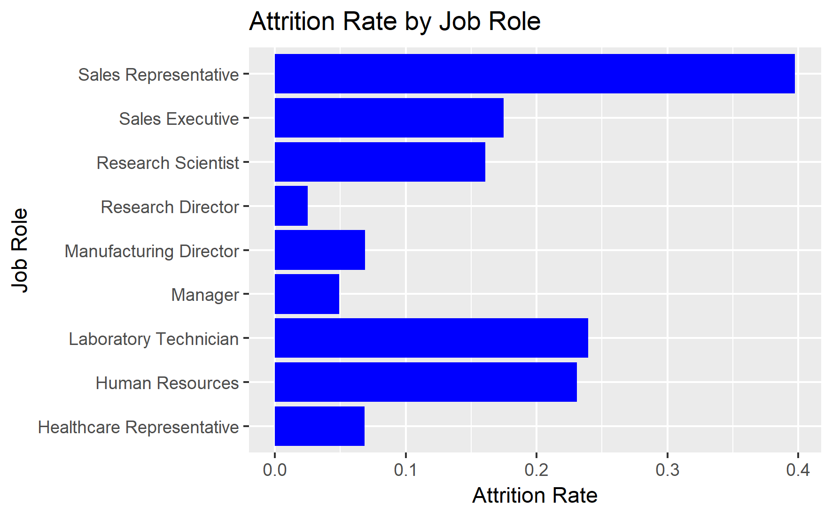
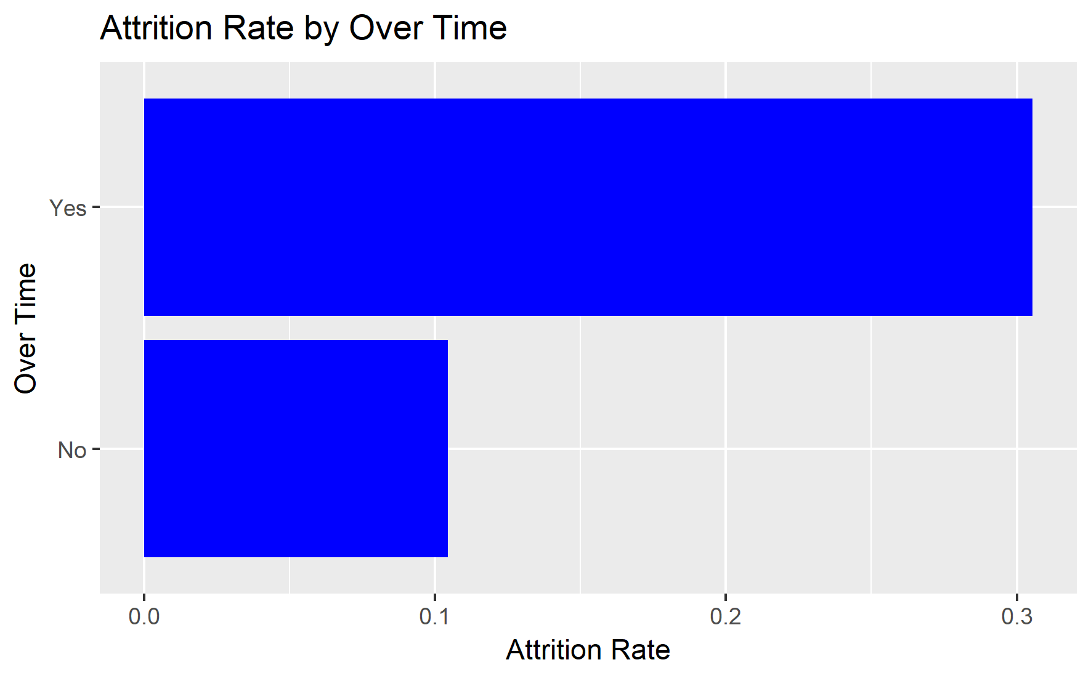
Attrition Rate Factors
Some examples of data:
Over Time plays a major factor in attrition rate
Sales Representatives have an extremely high rate of attrition

Slide 8
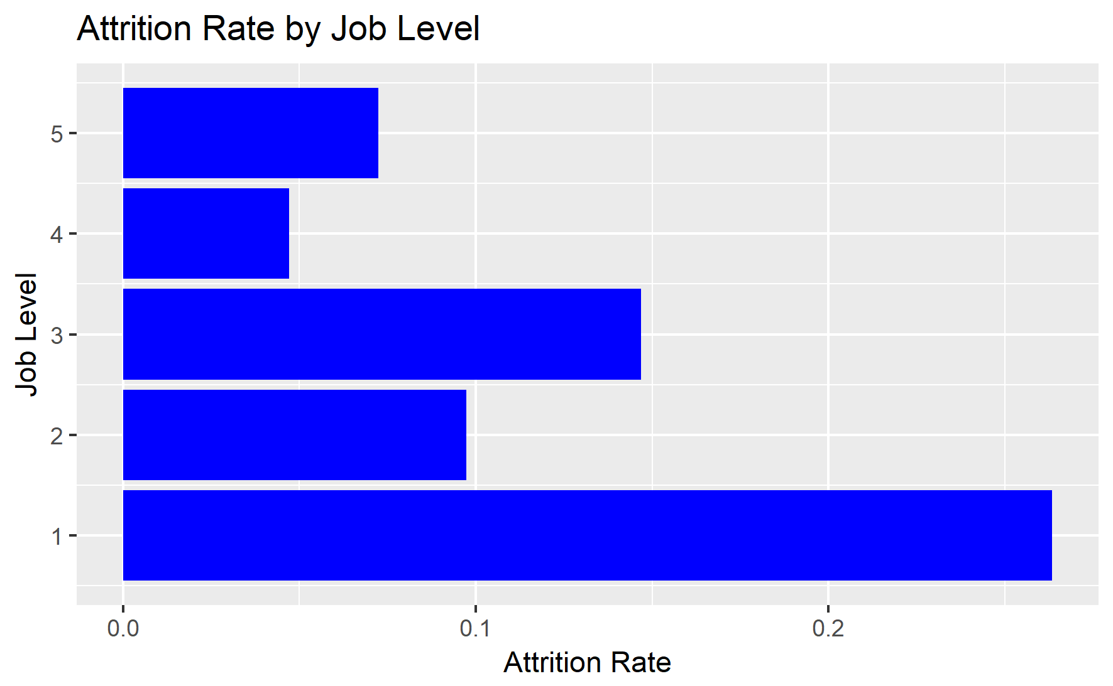
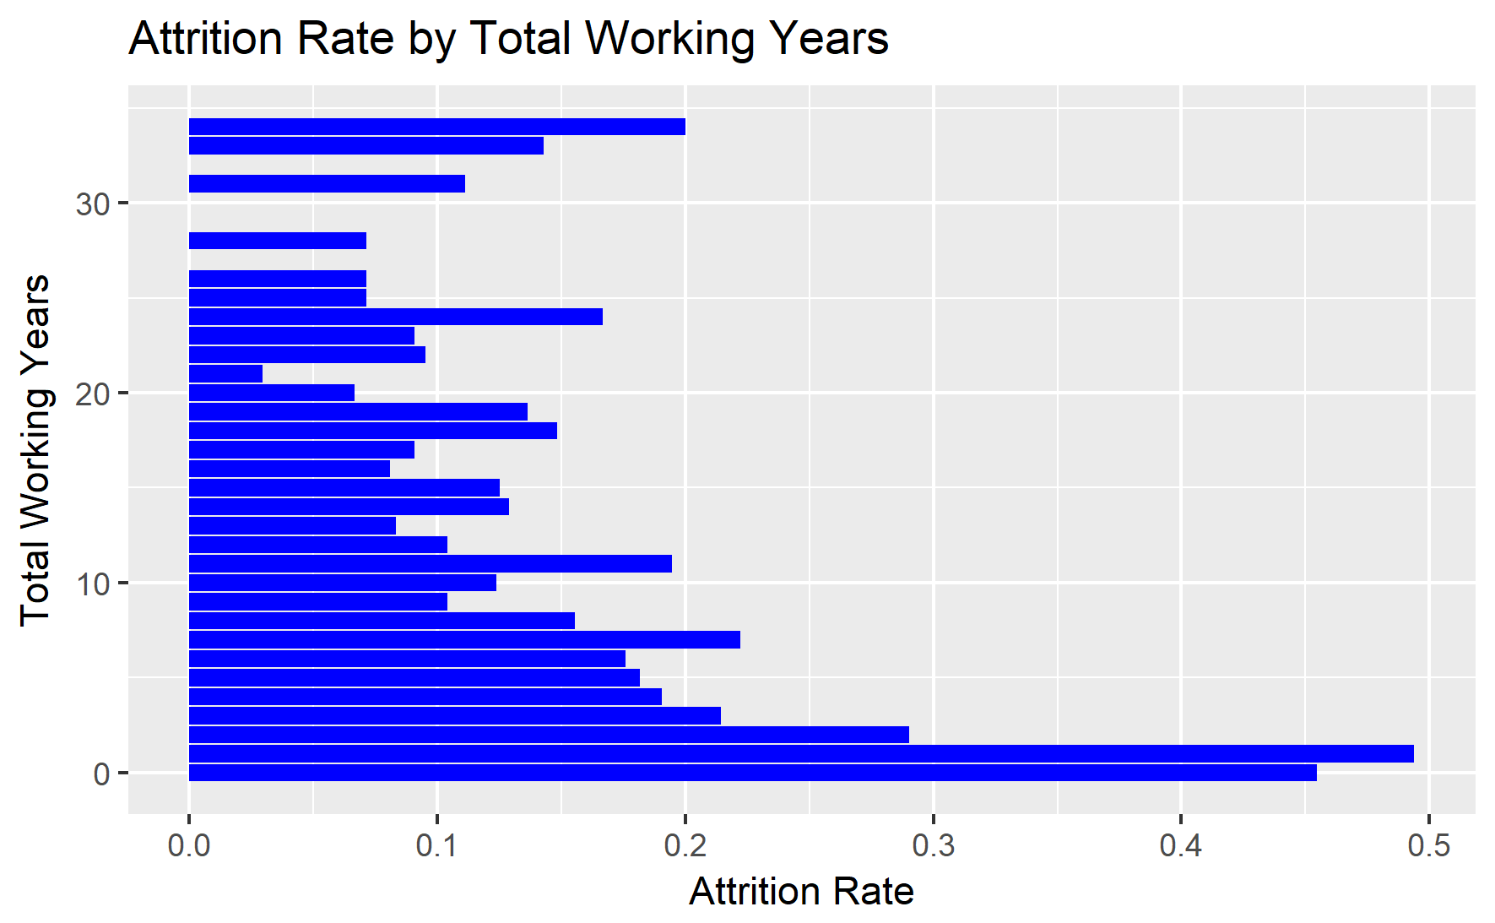
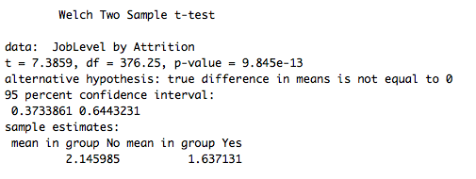
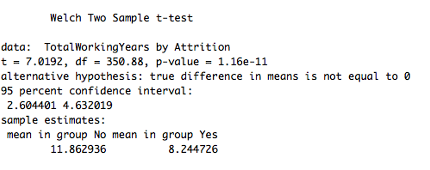
Attrition Rate Factors
Those who have a higher job level have a lower attrition rate. From a t test we can conclude the difference in means is not 0.

Slide 9
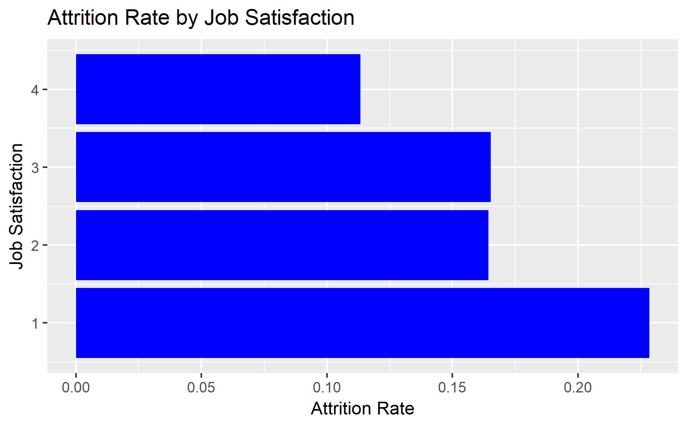
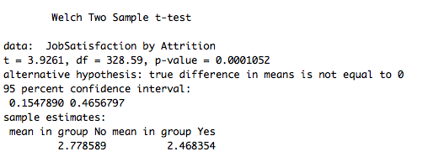
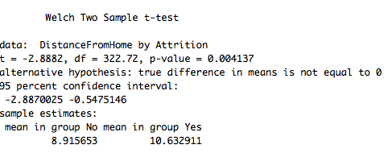
Attrition Rate Factors

Slide 10
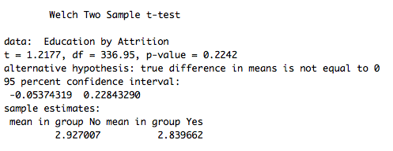
Attrition Rate Factors

Slide 11
Influential Variable Identification
The team used a combination of univariate, machine learning techniques to identify variables in the data which are important when predicting employee attrition
Process Overview:
Collinearity Assessment
Univariate modeling (logit, chi-square)
Machine learning (random forest and gradient boosted trees)
Determine Top-Variables Across Methods (stepwise AIC)

Slide 12
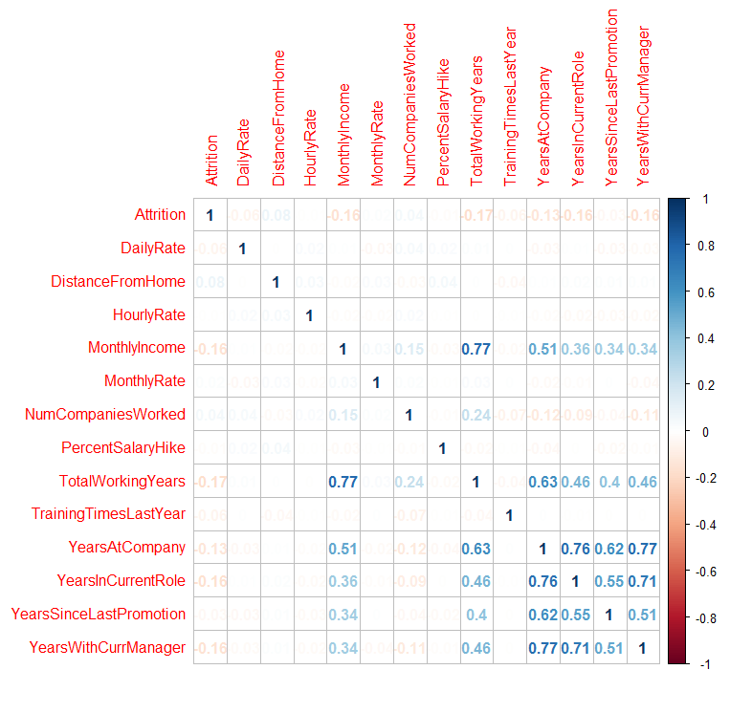
1) Collinearity Assessment
Some variables show some pairwise correlation, however none of the correlations are high enough to require variable removal since our variable identification methods are robust to collinearity

Slide 13
2) Univariate Modeling
Logit
Chi-Square
For each variable in the data a univariate logit model was run to assess how correlated the variable is with employee attrition
The models were ranked based on AIC and top-5 variables were retained for further analysis:
Overtime
Job Role
Job Level
Stock Option Level
Total Working Years
For each categorical variable in the data a univariate chi-square model was run to assess how correlated the variable is with employee attrition
The models were ranked based on p-value and top-5 variables were retained for further analysis:
Overtime
Job Role
Job Level
Stock Option Level
Job Involvment

Slide 14
3) Machine Learning
Random Forest
Gradent Boosted Model (gbm)
Bagging (bootstrap aggregation)
Fit many different regression trees independently using random sample of the data and random subset of the variables
Trees run independently in parallel then the results are combined
Boosting
Many trees are fit consecutively with additional tree trying to reduce the net error of the prior tree ensembles
Trees run consecutively and result is the model for the nth tree

Slide 15
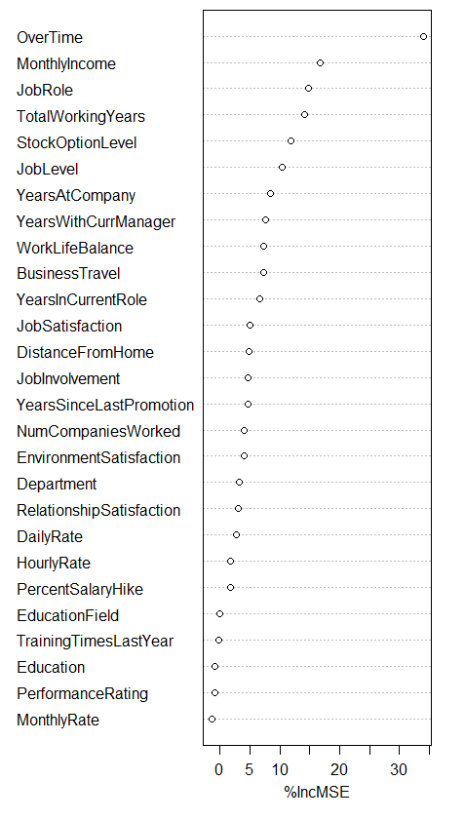
3) Machine Learning continued Random Forest
Random Forest
The random forest model uses variable inclusion mean-squared error to determine relative variable importance.
The top results of the RF model suggests that OverTime is a clear top variable for attrition.
The top-5 variables were selected for future analysis
Overtime
Monthly Income
Job Role
Total Working Years
Stock Level Option

Slide 16
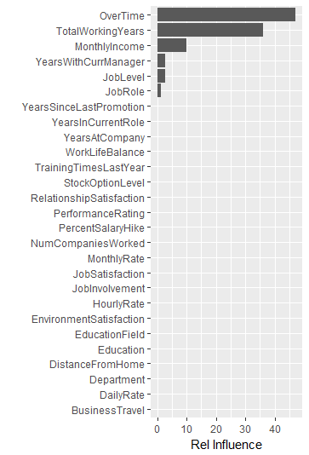
3) Machine Learning continued GBM
GBM
The GBM uses an aggregation of the reduction of sum of squared error on each iteration for each variable to create an estimate of relative influence
Only six of the variables result in a non-zero influence on Attrition in the GBM model.
These top-6 variables were selected for future analysis
Overtime
Total Working Years
Monthly Income
Years with current manager
Stock Level Option
Job Role

Slide 17
4) Top-Variables Across Methods
When combined across all previous methods the following list of variables were identified as top influencers of employee attrition:
Overtime, Job Level, Job Role, Total Working Years, Monthly Income, Years with current manager, Stock Option Level
By creating a model with all variables included and using AIC to stepwise backwards remove variables from the model we can reduce to total number to five:
Overtime
Stock Option Level
Job Role
Job Level
Years with current manager

Slide 18
4) Top-Variables Across Methods Continued
 | Odds Ratio | 95% CI | p-value
(Intercept) | 0.262 | (0.0914, 0.7355) | 0.011
OverTimeYes | 4.88 | (3.5272, 6.7926) | < 0.001
YearsWithCurrManager | 0.918 | (0.8684, 0.9689) | < 0.01
JobLevel2 | 0.243 | (0.1135, 0.4767) | < 0.001
JobLevel3 | 0.654 | (0.2672, 1.5172)
JobLevel4 | 0.35 | (0.085, 1.2475)
JobLevel5 | 2.659 | (0.3916, 24.0436)
JobRoleHuman Resources | 2.086 | (0.6563, 6.6149)
JobRoleLaboratory Technician | 2.173 | (0.7816, 6.1783)
JobRoleManager | 0.267 | (0.0342, 1.3577)
JobRoleManufacturing Director | 0.979 | (0.3645, 2.6572)
JobRoleResearch Director | 0.11 | (0.0101, 0.6566) | < 0.05
JobRoleResearch Scientist | 0.901 | (0.3164, 2.6087)
JobRoleSales Executive | 3.479 | (1.6652, 8.0492) | <0.01
JobRoleSales Representative | 3.327 | (1.091, 10.3026) | <0.05
StockOptionLevel1 | 0.286 | (0.1974, 0.4089) | <0.001
StockOptionLevel2 | 0.29 | (0.1435, 0.5414) | <0.001
StockOptionLevel3 | 0.491 | (0.2459, 0.9269) | <0.05
By examining the odds ratios of the variable coefficients from the logit model we are able to get a better estimate of how impactful the various variables are for predicting employee attrition
Some Highlight Insights:
If an employee is required to work overtime they are nearly five times more likely to leave the company
Once an employee reaches job level 2 they are around four times less likely to leave
The addition stock options reduces the likelihood of an employee leaving by two to four times compared to employees with no stock option

Slide 19
Trends within Variables
This will help us better understand the culture of each department and job role
Identify problem areas in the company

Slide 20
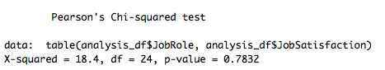
Trends within the Company
There is strong statistical evidence (p=0.7832) that job satisfaction and job role are independent of one another

Slide 21
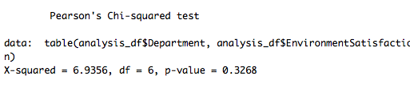
Trends within the Company
There is statistical evidence (p=0.3268) that department and environment satisfaction are independent of one another

Slide 22
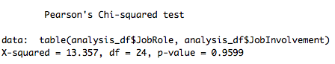
Trends within the Company
There is strong evidence (p=0.9599) that Job Role and Job Involvement are independent of one another

Slide 23
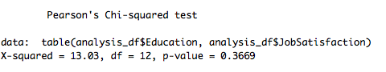
Trends Within the Company
Education Level does not have an impact on Job Satisfaction (p=0.36)

Slide 24
Trends Within Company
There does not appear to be a major difference between monthly income and job satisfaction

Slide 25
Trends within Company

Slide 26
Trends Within Company

Slide 27
Demographics
Purpose:
Knowing and understanding your employees leads to a healthier work culture
Can help manage the budget and reallocate money if necessary
Helps motivate employees
Creates better management

Slide 28
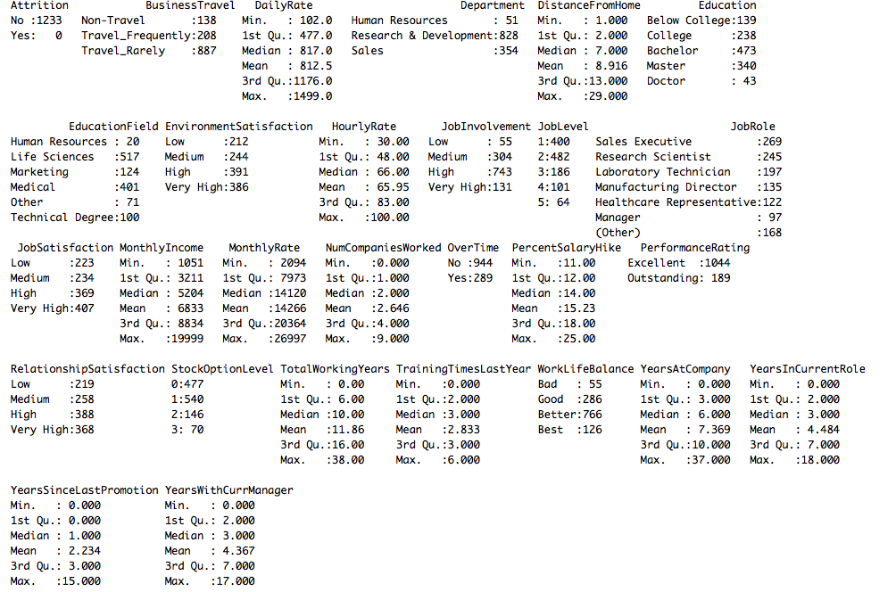
Demographics
17.19%
Only 4%
21.8%
23.4%
19.8%
62.9%
61.3%
Only 16.8% of employees travel requently
DDSAnalytics consists on 1233 employees
67.15% of employees are in the research department
69.42% of employees have a bachelor’s degree or higher
Life Sciences- 41.93%

Slide 29
Conclusion
Recorded data was useful for determining attrition
Different methodologies can lead to different conclusions about what variables are most important
Combining different measures, we determined that the top 5 variables determining attrition are:
Overtime
Stock Option Level
Job Role
Job Level
Years with current manager

